Slide 1
Board Chair Report
April 20, 2023

Slide 2
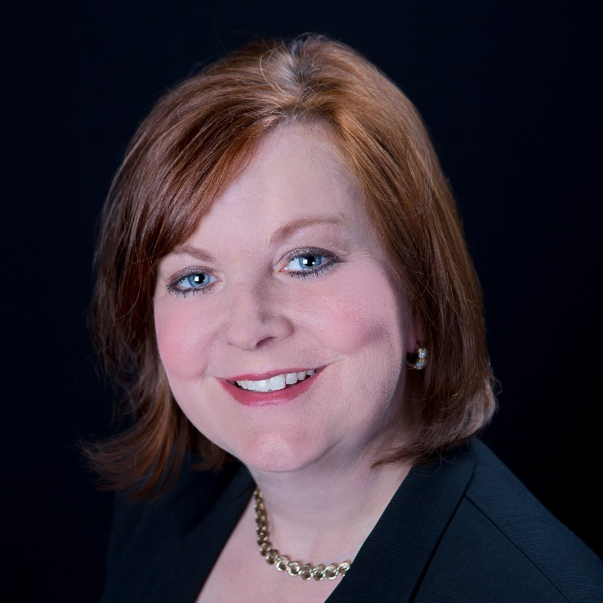
2023 Lieutenant Governor's Women of Achievement Award
Robin Wenneker

Slide 3
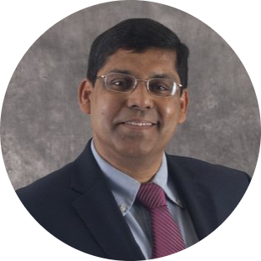
Curators' Distinguished Professor
Sajal Das Daniel St. Clair Endowed Chair Professor
Computer Science
Leading expert in cybersecurity, machine learning and data science, wireless sensor networks
More than 800 publications, 4 books, 57 book chapters and 5 US patents
Founder of a business incubator that has received $22M in grant funding
A Fellow of the Institute of Electrical and Electronics Engineers
Recipient of 12 Best Paper awards at international conferences

Slide 4
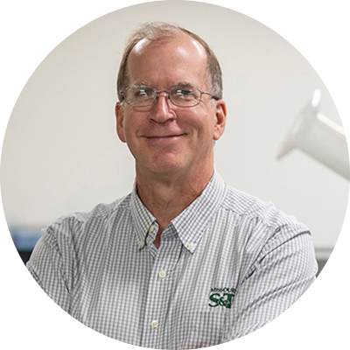
Curators' Distinguished Teaching Professor
David Westenberg Professor
College of Arts, Sciences, and Education
Expert in plant nutrition and bioremediation
Teaching covers the depth and breadth of the microbial sciences
Highest teaching load of the department and consistently high student evaluation scores
Developed 9 new courses
Awarded $1.2M in grants from the NSF and state to support K-12 teachers in STEM

